Slide 1
Model Evaluation Summary of Customer Booking Behavior
British Airways

Slide 2
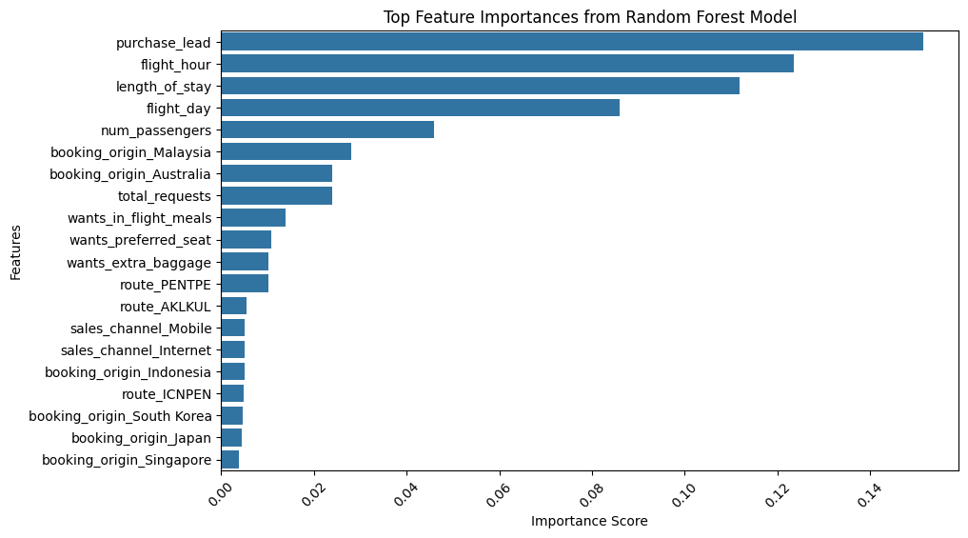
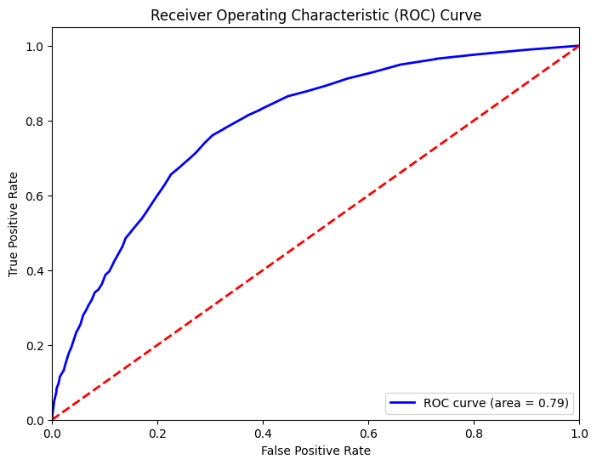
Random Forest Model Performance and Feature Importance
Model Performance
Feature Importance
Cross Validation mean score 71.51%
Accuracy on Test data
85.26%%

